Slide 1
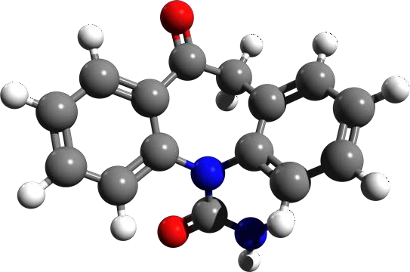
Structure & Union

Slide 2
Content
Introduction
Structure Definition
Accessing Structure Member
Array of Structure
Pointer to Structure
Function and Structure
Union

Slide 3
Introduction
C Structure is a collection of different data types which are grouped together and each element in a C structure is called member.
If you want to access structure members in C, structure variable should be declared.
Many structure variables can be declared for same structure and memory will be allocated for each separately.

Slide 4
Syntax for Structure Definition
struct
{
data-type Field1; data-type Field2;
………
};
tag_name

Slide 5
Example
struct
{
char name[20]; char author[10]; int pages;
float price;
} ;
book

Slide 6
Declaration of Variable
struct
{
int roll_no; char name[20]; float marks;
} s1,*s2;
student

Slide 7
Using Structure Tag
struct struct_tag variable-list;
struct student s1,*s2;
Variable can be declared inside(local) or outside(global) of main function

Slide 8
Memory Allocation
struct student s1 = {1,”Rupesh”,67.67};
s1.roll_no
s1.name
s1.marks
1 | R | u | p | e | s | h | \ 0 | G |  | V | 67.67
6502
6504
6024 6025
N=sizeof(s1);
N ???
N 58

Slide 9
Accessing Structure Member
Member Access Operator
  Dot (.) operator
  s1.name
Structure Pointer Operator
  Arrow (->) Operator
  s2->name

Slide 10


Slide 11
#include <stdio.h> struct student
{
char name[50]; int roll;
float marks;
};

Slide 12
int main()
{
struct student s;
// Structure Variable
printf("Enter information of students:\n\n"); printf("Enter name: "); scanf("%s",s.name); printf("Enter roll number: "); scanf("%d",&s.roll); printf("Enter marks: "); scanf("%f",&s.marks);

Slide 13
printf("\nDisplaying Information\n"); printf("Name: %s\n",s.name); printf("Roll: %d\n",s.roll); printf("Marks: %.2f\n",s.marks); return 0;
}

Slide 14
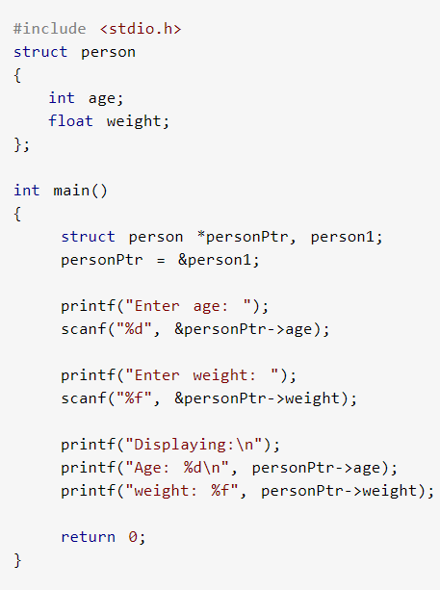
Access members using Pointer

Slide 15
Nested Structure
struct date
{
int day, mon, year;
};
Struct emp
{
char name[20]; struct date birthday; float salary;
};

Slide 16
Nested Structure
Struct emp
{
char name[20]; struct date
{
int day, mon, year;
} birthday;
float salary;
};

Slide 17
Nested Structure
struct emp e1 = {“Ratan”,{28,12,1937},68.4};
printf(“name =%s”,e1.name);
  Output : Ratan
Printf(“Month of Birth=%d”,e1.birthday.mon);
  Output ??

Slide 18
Nested Structure
struct emp e1 = {“Ratan”,{28,12,1937},68.4};
printf(“name =%s”,e1.name);
  Output : Ratan
Printf(“Month of Birth=%d”,e1.birthday.mon);
  Output : 12

Slide 19
Array of Structure
struct
{
int roll_no; char name[20]; float marks;
} s[100];
student

Slide 21
#include <stdio.h> struct employee
{
int emp_id; char name[20]; float salary;
int dept_no; int age;
};

Slide 22
Int main ( )
{
struct employee e[50]; int I,n;
printf(Enter No of Employee ); Scanf(“%d”,&n);

Slide 23
for (i=0; i<n; i++)
{
printf (“Enter employee id, name salary, departement id and age of employee”); scanf (“%d”,&e[i].emp_id);
scanf (“%s”,e[i].name);
scanf (“%f”,&e[i].salary);
scanf (“%d”,&e[i].dept_no);
scanf (“%d”,&e[i].age);
}

Slide 24
for (i=0; i<n; i++)
{
printf (“Employee id : %d”, e[i].emp_id); printf (“Name : %s”,e[i].name);
printf (“Salary : %f”, e[i].salary);
printf (“Department ID: %d”, e[i].dept_no); printf (“Age : %d”, e[i].age);
}
return 0;
}

Slide 25
Structure in Function
Parameter Passing
Return Value

Slide 26
Passing Parameter
#include <stdio.h>
struct employee
{
int emp_id;
char name[20];
float salary;
};
void printdata( struct employee emp)

Slide 27
Int main ( )
{
struct employee e;
printf (“Enter the employee id of employee”); scanf(“%d”,&e.emp_id);
printf (“Enter the name of employee”); scanf(“%s”,e.name);
printf (“Enter the salary of employee”); scanf(“%f”,&e.salary);
printdata (e); // f^{n} Call return 0;
}

Slide 28
void printdata( struct employee emp)
{
printf (“\nThe employee id of employee is : %d”,emp.emp_id); printf (“\nThe name of employee is : %s”, emp.name);
printf (“\nThe salary of employee is : %f”, emp.salary);
}

Slide 29
Return Value
#include <stdio.h>
struct employee
{
int emp_id;
char name[20];
float salary;
};
struct employee getdata( );

Slide 30
void main ( )
{
struct employee emp;
emp=getdata(); // fn Call
printf (“\nThe employee id is:%d”,emp.emp_id); printf (“\nThe name is : %s”, emp.name);
printf (“\nThe salary is : %f”, emp.salary); return 0;
}

Slide 31
struct employee getdata( )
{
struct employee e;
printf (“Enter the employee id of employee”); scanf(“%d”,&e.emp_id);
printf (“Enter the name of employee”); scanf(“%s”,e.name);
printf (“Enter the salary of employee”); scanf(“%f”,&e.salary);
return(e);
}

Slide 32
Union
Definition – C Union is also like structure, i.e. collection of different data types which are grouped together. Each element in a union is called member.
Union and structure in C are same in concepts, except allocating memory for their members.
Structure allocates storage space for all its members separately.
Whereas, Union allocates one common storage space for all its members

Slide 33
Union
We can access only one member of union at a time. We can’t access all member values at the same time in union.
But, structure can access all member values at the same time. This is because, Union allocates one common storage space for all its members. Where as Structure allocates storage space for all its members separately.

Slide 34
Syntax
union tag_name
{
data-type Field1; data-type Field2;
………
};

Slide 35
Memory Allocation
union student
{
int roll_no; char name[20]; float marks;
} s1,*s2; sizeof(s1)= ????

Slide 36
Memory Allocation
union student
{
int roll_no; char name[20]; float marks;
} s1,*s2;
sizeof(s1)= 20 byte (Field with Max sixe: Name)

Slide 37
Declaring union
Syntax:
union union_tag Variable_list;
Example:
union student report;

Slide 38
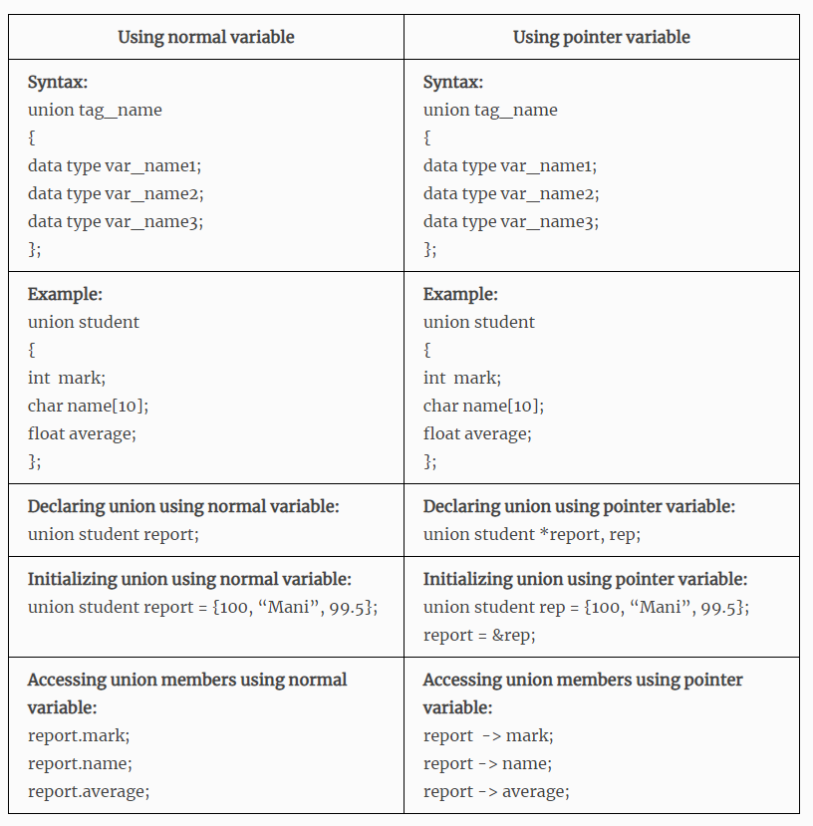
Declare a union, Initializing and Accessing the members

Slide 39
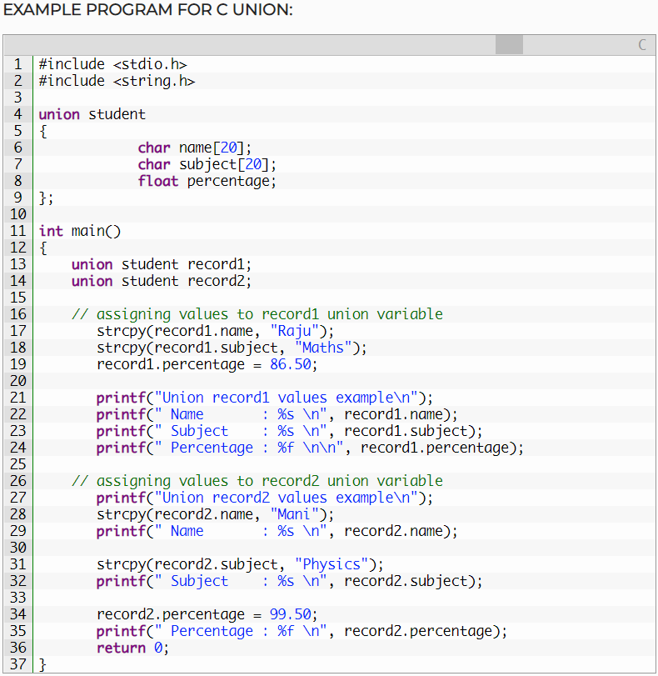

Slide 40
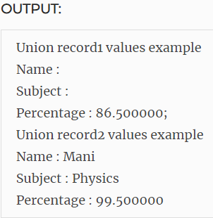

Slide 41
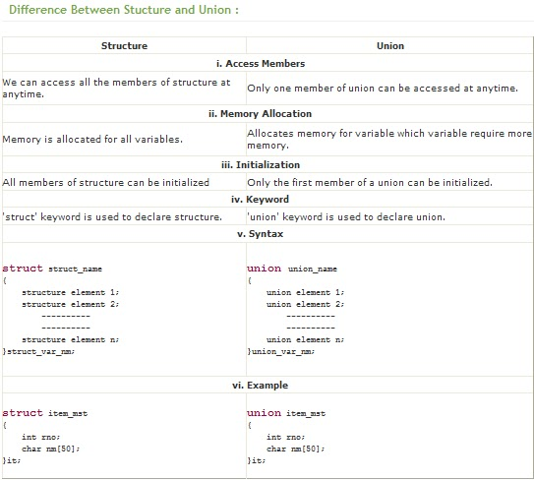

Slide 42
Exercise Program
Create a structure for students and perform read, write, compute average mark. Display the students scoring above and below the average marks for a class of N students.

Slide 43


